Slide 1


Final Year Project
Coach Selector– Find the Right Coach, Unlock Your Potential
Supervised By: Mr. Muhammad Usman Karim (Lecturer)

Slide 2
Project Team
Maaz Ejaz (35507)
Muhammad Umer Farooq (36509)
Muhammad Hateem Gulzar (37589)

Slide 3
Table of Content
Opportunity & Stakeholders
Existing Systems
Problem Statement
Endeavour (Team + Work + Way of Working)
System
Requirements Summary
Design Summary
Implementation Summary
Testing & Evaluation Summary
Conclusion and Outlook

Slide 4
Opportunity & Stakeholders

Slide 5
Opportunity
Coach Selector offers a complete solution for sports training by improving communication between players, coaches, and parents. It enables real-time session booking, performance tracking, and personalized feedback. Parents stay informed through a dedicated portal with updates on progress, attendance, and injuries. Advanced search, detailed analytics, and emergency support ensure effective and holistic player development.

Slide 6
Stakeholders
Players
Coaches
Academies
Parent/Guardians
Administrators(Platform Admin)

Slide 7
Existing Systems

Slide 8
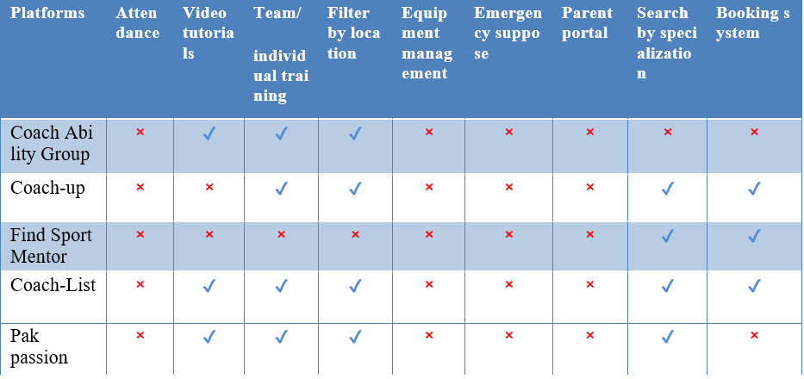
Existing Systems

Slide 9
Problem Statement

Slide 10
Problem Statement
Difficulty and monetizing coaching expertise
Inefficiency in talent identification and development
Lack of transparency in coach-player interaction
High drop-out rates in sports training

Slide 11
Solution

Slide 12
Solution
Monitoring all the reviews of coach by admin
Provide a centralized platform where coaches can showcase their expertise, certifications, and experience
Use detailed progress tracking and performance analytics to identify players strengths and area for improvement
Encourage parental involvement through portals that track progress, attendance, and injuries, creating a supportive environment
Provide detailed session records, attendance logs, and feedback reports accessible for players

Slide 13
Solution Cont.
Enable real-time communication through chat systems and notifications for session updates
Distinct profiles for coach and player lying the foundation for role-specification feature
Payment integration feature allows players to pay for the session

Slide 14
Endeavour

Slide 15
Endeavour
Describe roles of your team members
Team Composition
Team Members:
Maaz Ejaz
Muhammad Umer Farooq
M Hateem Gulzar

Slide 16
Endeavour
Roles:
All team members collaboratively worked on every aspect of the project, including development, documentation, testing, and design.
Describe your software development process
Requirement Gathering: Identified functional requirements using elicitation techniques (Observation of similar systems, brainstorming)

Slide 17
Endeavour
Analysis: Defined detailed use cases and created testable requirements documentation.
Design: Developed UML diagrams, including activity and designed the system's architecture.
Implementation: Built the application iteratively, ensuring modularity and adherence to coding standards.

Slide 18
Endeavour
Testing: Performed manual testing and created test cases to validate functionalities.
Describe your way of working as a team
Collaborative Approach: All team members contributed equally to every phase, including development, documentation, and testing.

Slide 19
Endeavour
Communication: Used tools like Google Meet for continuous coordination and progress sharing
Task Allocation: Distributed tasks dynamically based on immediate needs rather than fixed roles
Iterative Workflow: Followed an iterative cycle, completing small, manageable modules before integration.

Slide 20
Endeavour
Problem-Solving: Tackled challenges collectively, leveraging brainstorming sessions for solutions

Slide 21
Design Summary
The system design is structured using standard UML diagrams to ensure a clear representation of user interactions, system behaviour, architecture, and data management. The following components contribute to the comprehensive design of the platform:
Use Case Diagram
Activity Diagram
ERD Diagram
Deployment Diagram
MVC Diagram

Slide 22
Implementation Summary
The implementation of the Coach Selector system follows a modern development stack, using frameworks Laravel to ensure performance, scalability, and real-time capabilities.
List Development Technologies
Frontend: React
Backend: Laravel
Database: mySQL

Slide 23
Implementation Summary
List Development Tools
VS Code
Visual Paradigm
GitHub

Slide 24
Testing & Evaluation Summary
Testing Approach
Performed manual testing to ensure functionality aligns with requirements.
Test Artifacts
Created detailed test cases to validate system features.

Slide 25
Testing & Evaluation Summary
Focus Areas
User interface functionality. Core system workflows (e.g., login, profile creation, booking, Payment).

Slide 26
Conclusion and Outlook

Slide 27
Conclusion & Outlook
In conclusion, the Coach Selector platform effectively connects players, coaches, and parents by providing a unified interface for booking sessions, tracking progress, and managing communication. With clearly defined user roles, real-time chat, and personalized training tools, the system ensures an interactive, efficient, and transparent experience for all users involved in sports training.

